Slide 1
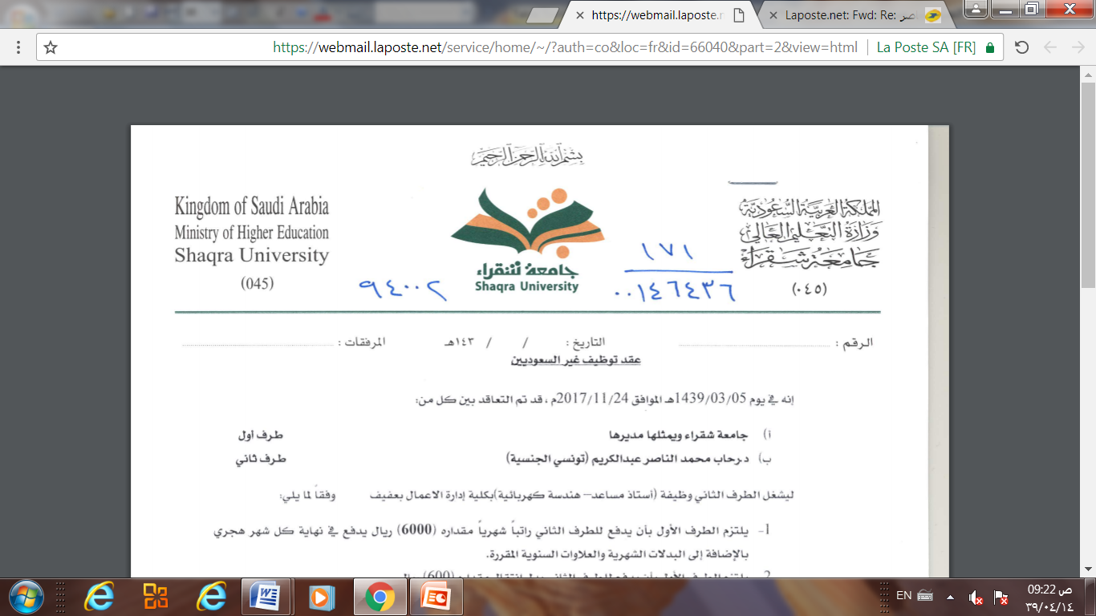
Database Management system
Chapter 4 (Part 1)
Basic Structured Query Language
Dr. Rihab Mohamed Naceur ABDELKRIM
E-mail: rihab@su.edu.sa
2017 - 2018

Slide 2
Chapter Outline
1-SQL Data Definition and Data Types
2-Specifying Constraints in SQL
3- Basic Retrieval Queries in SQL
4-INSERT, DELETE, and UPDATE Statements
in SQL
5- Additional Features of SQL

Slide 3
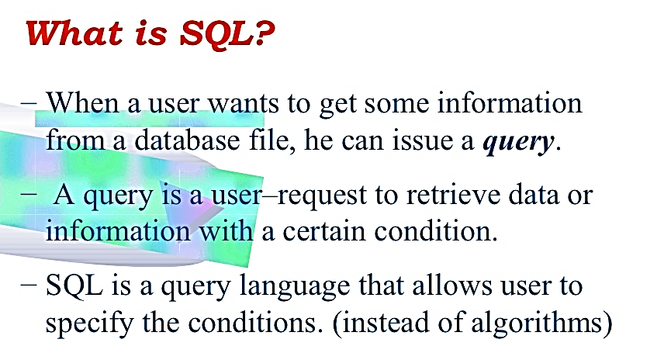
Introduction

Slide 4
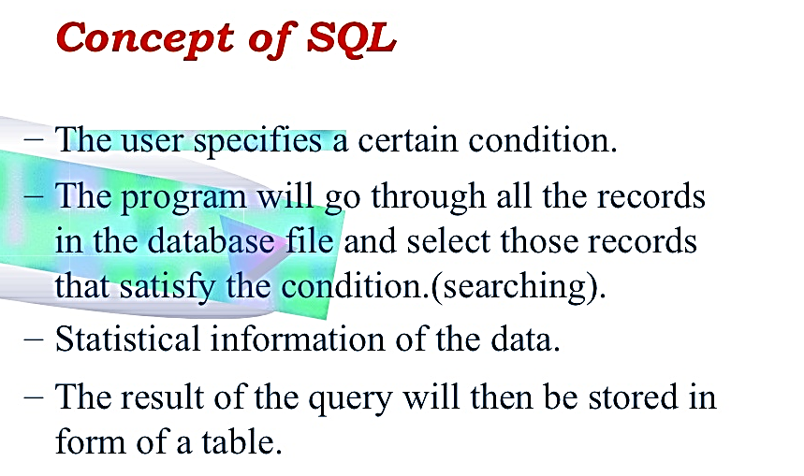
Introduction

Slide 5
1-SQL Data Definition and Data Types
1-1- Schema and Catalog Concepts in SQL
1-2- The CREATE TABLE Command in SQL
1-3- Attribute Data Types and Domains in SQL

Slide 6
1-SQL Data Definition and Data Types
1-1- Schema and Catalog Concepts in SQL
An SQL schema is identified by a schema name, and includes an authorization identifier to indicate the user or account who owns the schema, as well as descriptors for each element in the schema.
Schema elements include tables, constraints, views, domains, and other constructs (such as authorization grants) that describe the schema.
A schema is created via the CREATE SCHEMA statement, which can include all the schema elements’ definitions.

Slide 7
1-SQL Data Definition and Data Types
1-1- Schema and Catalog Concepts in SQL
semicolon
Example
CREATE SCHEMA COMPANY AUTHORIZATION ‘Jsmith’;
In general, not all users are authorized to create schemas
and schema elements.
The privilege to create schemas, tables, and other
constructs must be explicitly granted to the relevant user accounts by the system administrator or DBA.
A catalog always contains a special schema called INFORMATION_SCHEMA, which provides information
on all the schemas in the catalog and all the element descriptors in these schemas.

Slide 8
1-SQL Data Definition and Data Types
1-2- The CREATE TABLE Command in SQL
The CREATE TABLE command is used to specify a new relation by giving it a name and specifying its attributes and initial constraints.
The attributes are specified first, and each attribute is given a name, a data type to specify its domain of values, and any attribute constraints, such as NOT NULL.
The key, entity integrity, and referential integrity constraints can be specified within the CREATE TABLE statement after the attributes are declared.

Slide 9
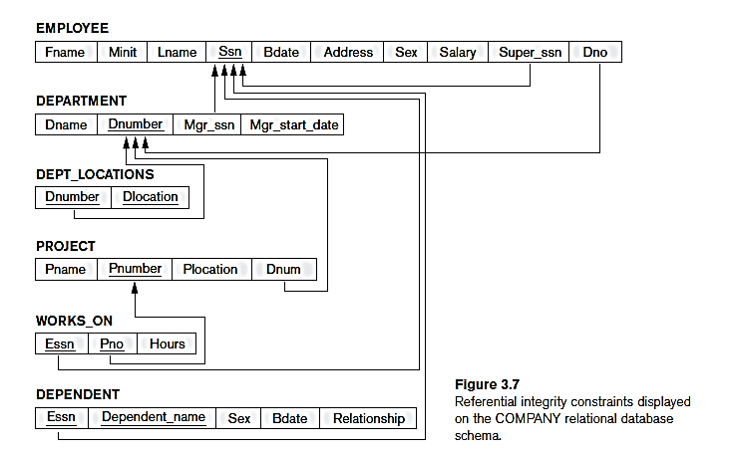
1-SQL Data Definition and Data Types
1-2- The CREATE TABLE Command in SQL
Typically, the SQL schema in which the relations are declared is implicitly specified in the environment in
which the CREATE TABLE statements are executed.
Example

Slide 10
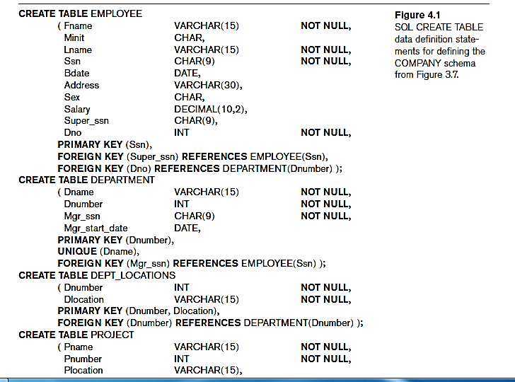
1-SQL Data Definition and Data Types
1-2- The CREATE TABLE Command in SQL
Example

Slide 11
1-SQL Data Definition and Data Types
1-3- Attribute Data Types and Domains in SQL
The basic data types available for attributes include numeric, character string, bit string, Boolean, date, and time.
char(n) (or character(n)): fixed-length character string, with user-specified length.
varchar(n) (or character varying): variable-length character string, with user-specified maximum length.
int or integer: an integer (length is machine-dependent).
smallint: a small integer (length is machine-dependent).

Slide 12
1-SQL Data Definition and Data Types
1-3- Attribute Data Types and Domains in SQL
numeric(p, d): a fixed-point number with user-specified precision, consists of p digits (plus a sign) and d of p digits are to the right of the decimal point.
E.g., numeric(3, 1) allows 44.5 to be stored exactly but not 444.5.
Real or double precision: floating-point or double-precision floating-point numbers, with machine-dependent precision.
float(n): floating-point, with user-specified precision of at least n digits.
.

Slide 13
1-SQL Data Definition and Data Types
1-3- Attribute Data Types and Domains in SQL
date: a calendar date, containing four digit year, month, and day of the month.
time: the time of the day in hours, minutes, and seconds
Example
we can create a domain SSN_TYPE by the following statement:
CREATE DOMAIN SSN_TYPE AS CHAR(9);

Slide 14
2-Specifying Constraints in SQL
2-1- Specifying Attribute Constraints and Attribute Defaults
2-2- Specifying Key and Referential Integrity Constraints
2-3- Giving Names to Constraints
2-4-Specifying Constraints on Tuples Using CHECK

Slide 15
2-Specifying Constraints in SQL
This section describes the basic constraints that can be specified in SQL as part of table creation.
These include key and referential integrity constraints, restrictions on attribute domains and NULLs, and constraints on individual tuples within a relation.
We discuss the specification of more general constraints, called assertions, in Chapter 5.

Slide 16
2-Specifying Constraints in SQL
2-1- Specifying Attribute Constraints and Attribute Defaults
Because SQL allows NULLs as attribute values, a constraint NOT NULL may be specified if NULL is not permitted for a particular attribute.
This is always implicitly specified for the attributes that are part of the primary key of each relation, but it can be specified for any other attributes whose values are required not to be NULL, as shown in Figure 4.1.
It is also possible to define a default value for an attribute by appending the clause DEFAULT <value> to an attribute definition.
The default value is included in any new tuple if an explicit value is not provided for that attribute.

Slide 17
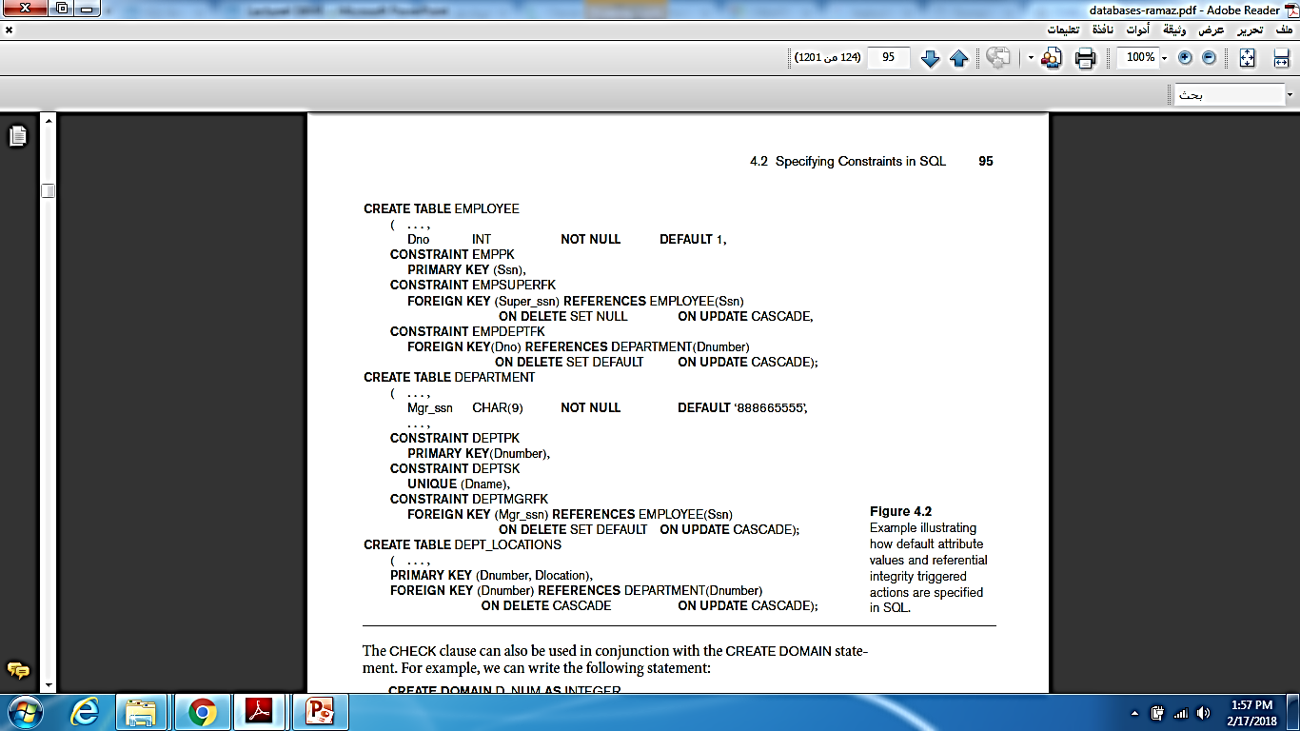
2-Specifying Constraints in SQL
2-1- Specifying Attribute Constraints and Attribute Defaults
Figure 4.2 illustrates an example of specifying a default manager for a new department and a default department for a new employee.
Example

Slide 18
2-Specifying Constraints in SQL
2-1- Specifying Attribute Constraints and Attribute Defaults
Another type of constraint can restrict attribute or domain values using the CHECK clause following an attribute or domain definition.
For example, suppose that department numbers are restricted to integer numbers between 1 and 20; then, we can change the attribute declaration of Dnumber in the DEPARTMENT table (see Figure 4.1) to the following:
Dnumber INT NOT NULL CHECK (Dnumber > 0 AND Dnumber < 21);
Example

Slide 19
2-Specifying Constraints in SQL
2-2- Specifying Key and Referential Integrity Constraints
Because keys and referential integrity constraints are very important, there are special clauses within the CREATE TABLE statement to specify them.
The PRIMARY KEY clause specifies one or more attributes that make up the primary key of a relation.
If a primary key has a single attribute, the clause can follow the attribute directly. For example, the primary key of DEPARTMENT can be specified as follows
(instead of the way it is specified in Figure 4.1):
Dnumber INT PRIMARY KEY;

Slide 20
2-Specifying Constraints in SQL
2-2- Specifying Key and Referential Integrity Constraints
The UNIQUE clause specifies alternate (secondary) keys, as illustrated in the DEPARTMENT and PROJECT table declarations in Figure 4.1.
The UNIQUE clause can also be specified directly for a secondary key if the secondary key is a single attribute, as in the following example:
Dname VARCHAR(15) UNIQUE;
Referential integrity is specified via the FOREIGN KEY clause, as shown in Figure 4.1.

Slide 21
2-Specifying Constraints in SQL
2-2- Specifying Key and Referential Integrity Constraints
a referential integrity constraint can be violated when tuples are inserted or deleted, or when a foreign key or primary key attribute value is modified.
The default action that SQL takes for an integrity violation
is to reject the update operation that will cause a violation, which is known as the RESTRICT option.
However, the schema designer can specify an alternative action to be taken by attaching a referential triggered action clause to any foreign key constraint.
The options include SET NULL, CASCADE, and SET DEFAULT.
An option must be qualified with either ON DELETE or ON UPDATE.

Slide 22
2-Specifying Constraints in SQL
2-3- Giving Names to Constraints
Figure 4.2 also illustrates how a constraint may be given
a constraint name, following the keyword CONSTRAINT.
The names of all constraints within a particular schema must be unique.

Slide 23
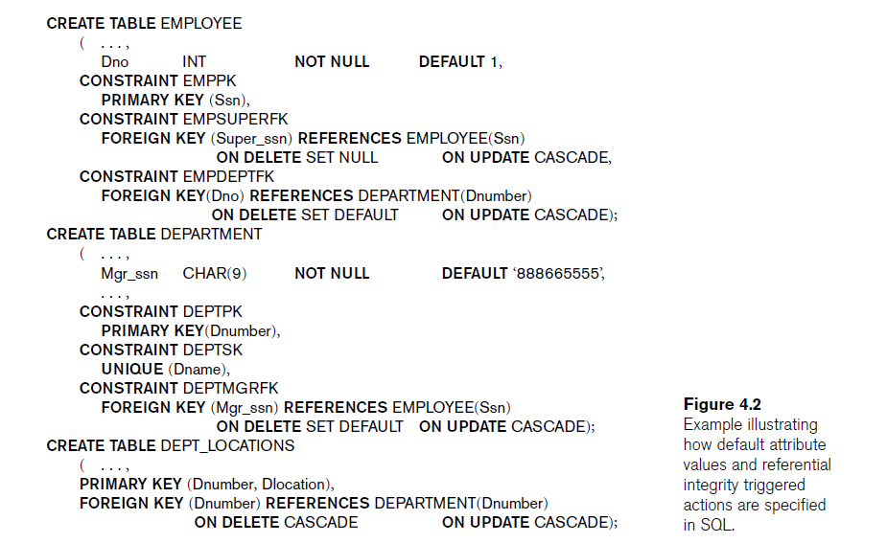
2-Specifying Constraints in SQL
2-3- Giving Names to Constraints
Example

Slide 24
2-Specifying Constraints in SQL
2-4-Specifying Constraints on Tuples Using CHECK
Then we could add the following CHECK clause at the end of the CREATE TABLE statement for the DEPARTMENT table to make sure that a manager’s start date is later than the department creation date.
CHECK (Dept_create_date <= Mgr_start_date);
Example

